Slide 1
自然語言處理實作
楊新章
國立高雄大學資訊管理學系

Slide 2
自然語言處理套件安裝
pip install nltk
nltk.download()
pip install jieba
https://raw.githubusercontent.com/fxsjy/jieba/master/extra_dict/dict.txt.big
pip install scikit-learn
pip install requests
pip install beautifulsoup4

Slide 3
文件搜尋
使用Google搜尋
import requests
payload = {'q': 'artificial+intelligence'}
# 使用Google搜尋
html = requests.get("https://www.google.com/search", params=payload)
# 使用Google學術搜尋
html = requests.get("https://scholar.google.com.tw/scholar", params=payload)
print(html.url)
print(html.text)

Slide 4
網頁解析
使用BeautifulSoup
from bs4 import BeautifulSoup
soup = BeautifulSoup(html.text, 'html.parser')
print(soup.prettify())

Slide 5
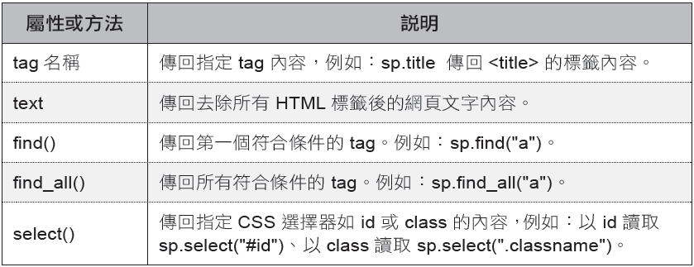
網頁解析
BeautifulSoup 的屬性和方法
BeautifulSoup 常用的屬性和方法如下：( 表中假設已建立 BeautifulSoup 型別物件 sp)

Slide 6
網頁解析
尋找標籤
範例：尋找網頁中之超連結
a_tags = soup.find_all('a')
for tag in a_tags:
# 輸出超連結的文字
print(tag.string)
取出節點屬性(get方法)
範例：
for tag in a_tags:
# 輸出超連結網址
print(tag.get('href'))

Slide 7
網頁解析
尋找指定標籤中符合屬性條件的內容
範例：讀取所有的 <a> 標籤中 id=link2 的內容
data1 = soup.find_all('a', {'id':'link2'})

Slide 8
網頁解析
範例：淬取Google學術搜尋結果中之PDF檔
import requests
from bs4 import BeautifulSoup
payload = {'q': 'artificial+intelligence'}
html = requests.get("https://scholar.google.com.tw/scholar", params=payload)
soup = BeautifulSoup(html.text, 'html.parser')
current_link = ''
for div in soup.find_all('div', {'class': 'gs_or_ggsm'}):
current_link = div.find('a').get('href')
if current_link.endswith('pdf'):
print('Download pdf: ' + current_link)

Slide 9
文字淬取
將各類文件中之文字內容取出
使用套件範例: textract
pip install textract
import textract
text = textract.process('路徑\檔名.副檔名') # 注意路徑分隔字元
print(text.decode('utf8'))

Slide 10
斷詞
使用NLTK進行英文斷詞
import nltk
seg_text = nltk.word_tokenize(text)
print(seg_text)

Slide 11
斷詞
使用Jieba進行中文斷詞
import jieba
jieba.set_dictionary('./dict.txt.big.txt')
seg_text = jieba.cut(text)
print(seg_text)

Slide 12
斷句
使用NLTK進行英文斷句
from nltk.tokenize import sent_tokenize
sentences = sent_tokenize(text)
中文斷句
import re
sentences = re.split('(。|！|\!|\.|？|\?)', text)

Slide 13
常用詞去除
使用NLTK去除英文常用詞
from nltk.corpus import stopwords
filters = stopwords.words('english')
nostop_text = [word for word in seg_text if word.lower() not in filters]

Slide 14
常用詞去除
使用任何常用詞典去除常用詞
def remove_stop_words(file_name, seg_text):
with open(file_name, 'r') as f:
stop_words = f.readlines()
stop_words = [stop_word.rstrip() for stop_word in stop_words]
for seg in seg_text:
if seg not in stop_words:
new_list.append(seg)
return new_list
file_name = './stopwords.txt'
seg_text = remove_stop_words(file_name, seg_text)
print('remove_stop_words: ', seg_text)

Slide 15
字根還原
使用NLTK
from nltk.stem.porter import PorterStemmer
porter_stemmer = PorterStemmer()
stemmed_words = []
for word in seg_text:
stemmed_words.append(porter_stemmer.stem(word))

Slide 16
文件向量化與相似度計算
使用scikit-learn計算文件間相似度
from sklearn.feature_extraction.text import TfidfVectorizer
text_files = ['doc1.txt', 'doc2.txt', 'doc3.txt']
documents = [open(f).read() for f in text_files]
tfidf = TfidfVectorizer().fit_transform(documents)
# no need to normalize, since Vectorizer will return normalized tf-idf
pairwise_similarity = tfidf * tfidf.T
計算二份文件間之相似度
tfidf = TfidfVectorizer().fit_transform([text1, text2])
sim = ((tfidf * tfidf.T).A)[0,1]

Slide 17
文件分類
使用scikit-learn為例
讀取資料檔
from sklearn.datasets import fetch_20newsgroups
twenty_train = fetch_20newsgroups(subset='train', shuffle=True)
twenty_train.target_names #prints all the categories
print("\n".join(twenty_train.data[0].split("\n")[:3])) #prints first line of the first data file

Slide 18
文件分類
建立特徵向量
from sklearn.feature_extraction.text import CountVectorizer
count_vect = CountVectorizer()
X_train_counts = count_vect.fit_transform(twenty_train.data)
X_train_counts.shape
from sklearn.feature_extraction.text import TfidfTransformer
tfidf_transformer = TfidfTransformer()
X_train_tfidf = tfidf_transformer.fit_transform(X_train_counts)
X_train_tfidf.shape

Slide 19
文件分類
使用分類器(以Naïve Bayes為例)
from sklearn.naive_bayes import MultinomialNB
text_clf = MultinomialNB().fit(X_train_tfidf, twenty_train.target)
import numpy as np
twenty_test = fetch_20newsgroups(subset='test', shuffle=True)
X_test_counts = count_vect.fit_transform(twenty_test.data)
X_test_tfidf = tfidf_transformer.fit_transform(X_test_counts)
predicted = text_clf.predict(X_test_tfidf)
np.mean(predicted == twenty_test.target)

Slide 20
文件分類
使用分類器(以Support Vector Machine為例)
from sklearn.linear_model import SGDClassifier
test_clf = SGDClassifier(loss="hinge", penalty="l2")
import numpy as np
twenty_test = fetch_20newsgroups(subset='test', shuffle=True)
X_test_counts = count_vect.fit_transform(twenty_test.data)
X_test_tfidf = tfidf_transformer.fit_transform(X_test_counts)
predicted = text_clf.predict(X_test_tfidf)
np.mean(predicted == twenty_test.target)

Slide 21
課程大綱
實作練習

Slide 22
實作練習
請以上節範例程式碼進行操作練習
安裝所需套件
輸入並執行各範例程式
請結合上節範例撰寫一程式滿足下列要求：
讀入兩文件
淬取文件中之文字內容
進行前置處理(斷詞、常用字刪除、字根還原、文件向量化…)
計算兩份文件之相似度

